Slide 1
Classification
Decision Tree
- classification and regression

Slide 2
Two Types of Decision Tree
Classification
Classification trees are applied on data when the outcome is discrete in nature or is categorical such as presence or absence of students in a class, a person died or survived, approval of loan
Regression
Regression trees are used when the outcome of the data is continuous in nature such as prices, age of a person, length of stay in a hotel, etc.

Slide 3
Decision Tree Algorithms
ID3, C4.5, AND CART

Slide 4
ID3 – Iterative Dichotomiser 3
ID3 generates a tree by considering the whole set S as the root node.
It then iterates on every attribute and splits the data into fragments known as subsets to calculate the entropy or the information gain of that attribute.
After splitting, the algorithm recourses on every subset by taking those attributes which were not taken before into the iterated ones.
It is not an ideal algorithm as it generally overfits the data and on continuous variables, splitting the data can be time consuming.

Slide 5
C4.5
It is quite advanced compared to ID3.
The splitting is done based on the normalized information gain and the feature having the highest information gain makes the decision.
Unlike ID3, it can handle both continuous and discrete attributes very efficiently and after building a tree, It undergoes pruning by removing all the branches having low importance

Slide 6
CART - Classification and Regression Trees
CART can perform both classification and regression tasks and they create decision points by considering Gini index unlike ID3 or C4.5 which uses information gain for split.
For splitting, CART follows a greedy algorithm which aims only to reduce the cost function.
For classification, cost function such as Gini index is used to indicate the purity of the leaf nodes.
For regression, sum squared error is chosen by the algorithm as the cost function to find out the best prediction.

Slide 7
CHAID
CHAID or Chi-square Automatic Interaction Detector is a process which can deal with any type of variables be it nominal, ordinal or continuous.
In regression tree, it uses F-test and in classification trees, it uses the Chi-Square test.
In this analysis, continuous predictors are separated into equal number of observations until an outcome is achieved.
It is very less used and adopted in real world problems compared to other algorithms.

Slide 8
Splitting Criterias
Entropy, Information gain, Gini Index, Chi-Square and Reduction in Variance

Slide 9
Splitting Criteria
Entropy
Information Gain
Gini Index
Chi - square
Reduction in variance

Slide 10

Entropy
It is defined as a measure of impurity present in the data.
The entropy is almost zero when the sample attains homogeneity but is one when it is equally divided.
Entropy with the lowest value makes a model better in terms of prediction as it segregates the classes better.

Slide 11
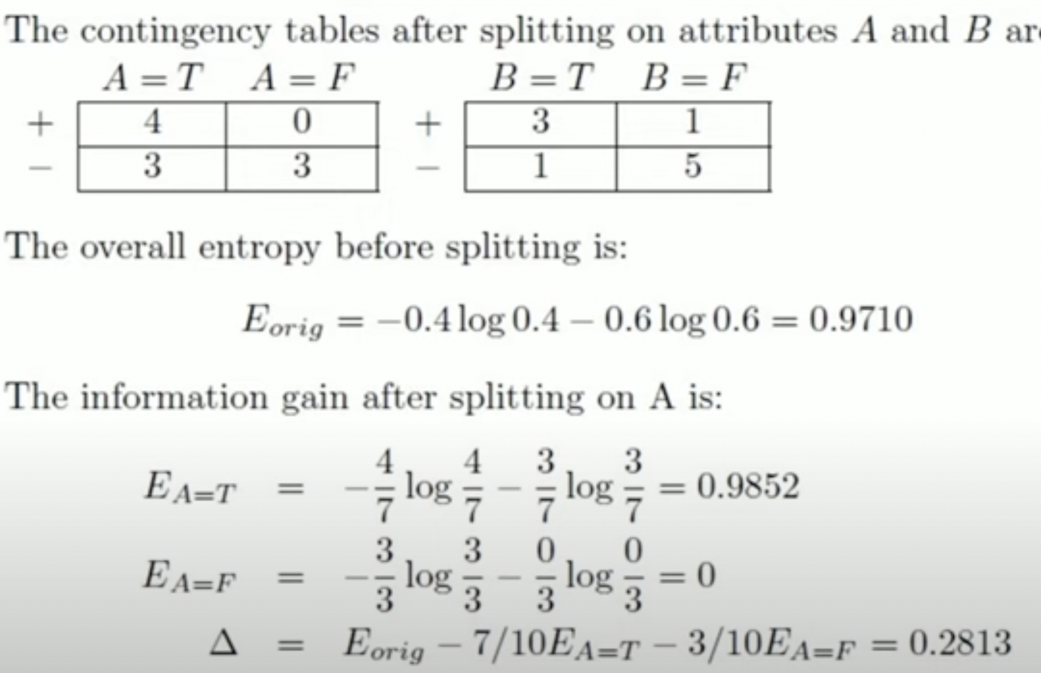
Example - Entropy
A | B | Class
T | F | +
T | T | +
T | T | +
T | F | -
T | T | +
F | F | _
F | F | _
F | F | _
T | T | _
T | F | _

Slide 12
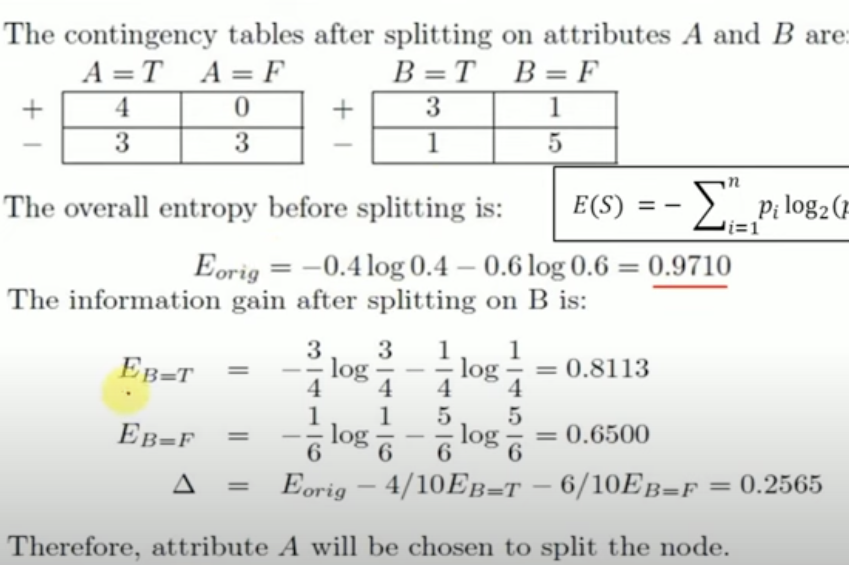
Example - Entropy
A | B | Class
T | F | +
T | T | +
T | T | +
T | F | -
T | T | +
F | F | _
F | F | _
F | F | _
T | T | _
T | F | _

Slide 13
Information Gain
It is a measure used to generalize the impurity which is entropy in a dataset.
Higher the information gain, lower is the entropy.
An event having low probabilities to occur has lower entropy and high information whereas an event having high probabilities has higher entropy and low information. It is calculated as
Information Gain = Entropy of Parent – sum (weighted % * Entropy of Child)

Slide 14
Example – Information Gain
A | B | Class
T | F | +
T | T | +
T | T | +
T | F | -
T | T | +
F | F | _
F | F | _
F | F | _
T | T | _
T | F | _

Slide 15
Example – Information Gain
A | B | Class
T | F | +
T | T | +
T | T | +
T | F | -
T | T | +
F | F | _
F | F | _
F | F | _
T | T | _
T | F | _

Slide 16
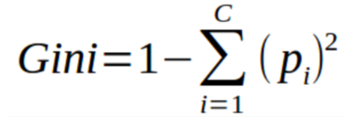
Gini Index
It is a measure of misclassification and is used when the data contain multi class labels.
Gini is similar to entropy but it calculates much quicker than entropy.
Algorithms like CART (Classification and Regression Tree) use Gini as an impurity parameter.

Slide 17
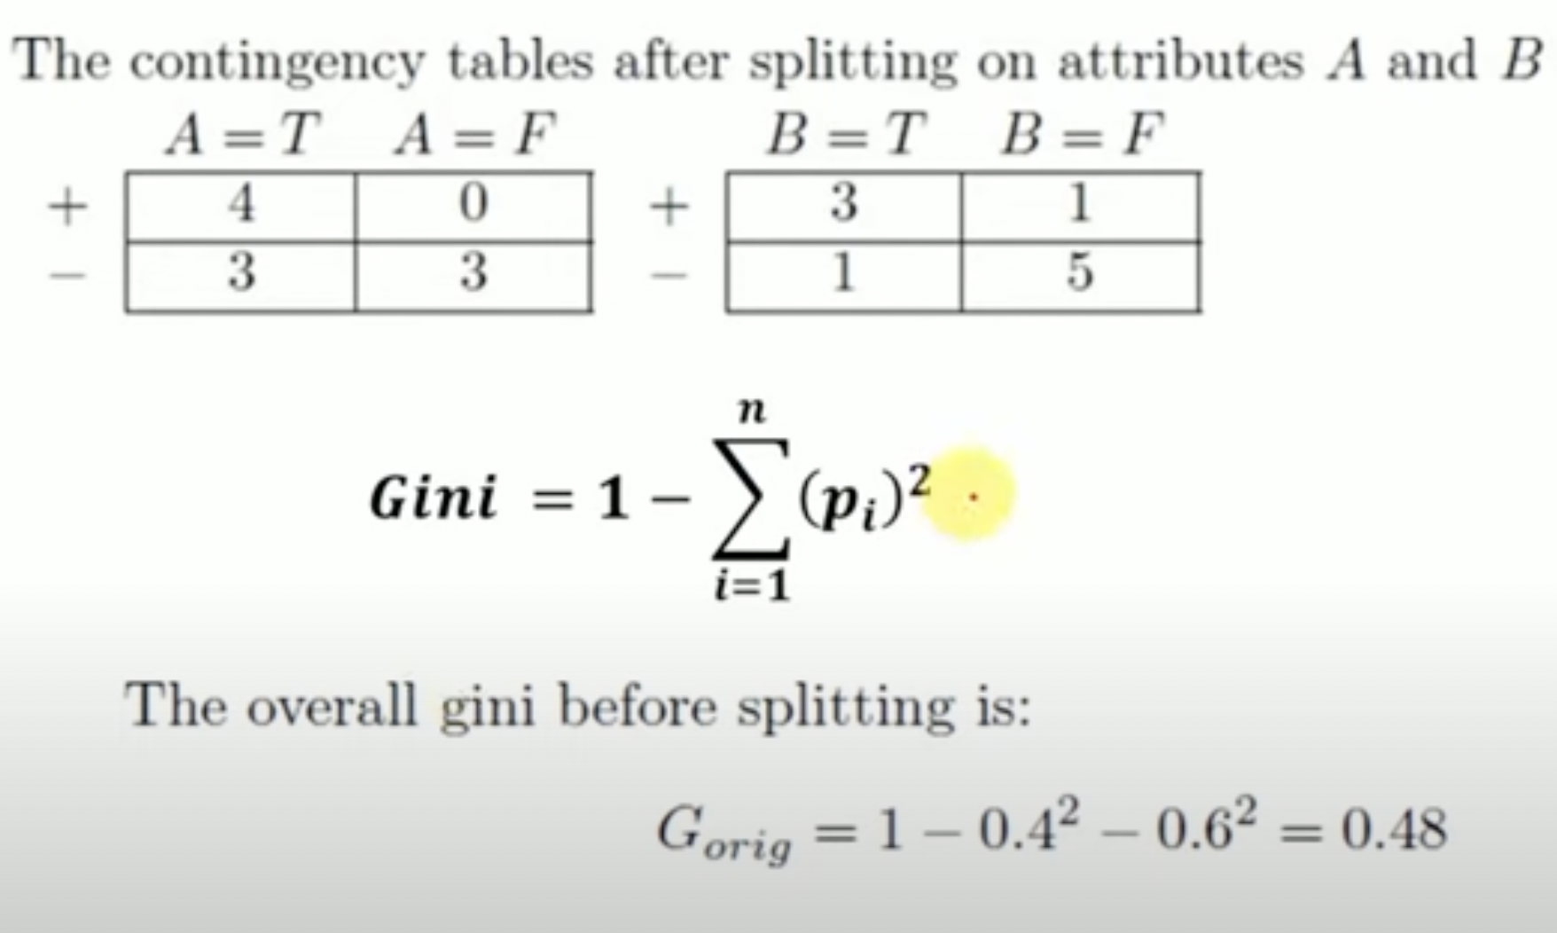
Example – Gini Index
A | B | Class
T | F | +
T | T | +
T | T | +
T | F | -
T | T | +
F | F | _
F | F | _
F | F | _
T | T | _
T | F | _

Slide 18
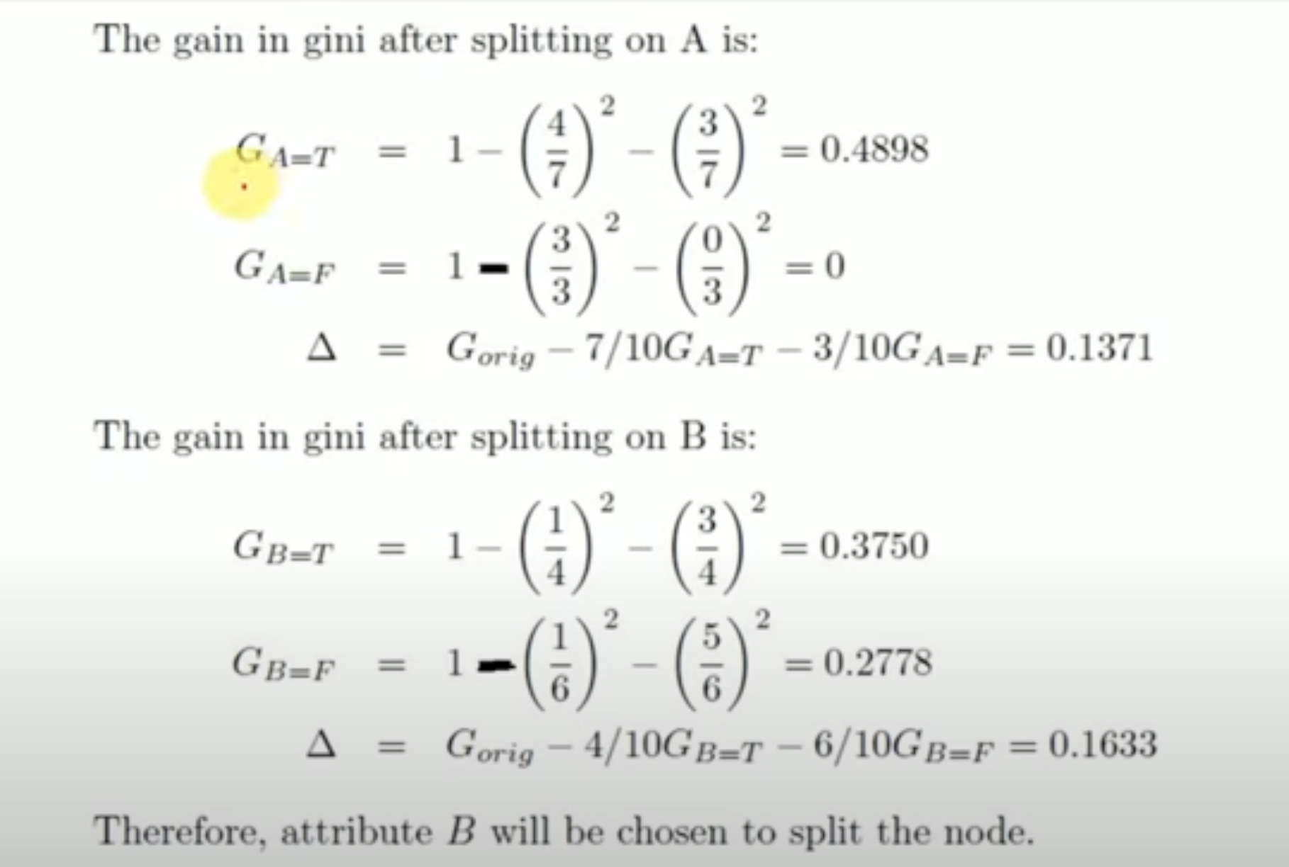
Example – Gini Index
A | B | Class
T | F | +
T | T | +
T | T | +
T | F | -
T | T | +
F | F | _
F | F | _
F | F | _
T | T | _
T | F | _

Slide 19
Example – Gini Index
A | B | Class
T | F | +
T | T | +
T | T | +
T | F | -
T | T | +
F | F | _
F | F | _
F | F | _
T | T | _
T | F | _

Slide 20

Chi-Square
Let’s now understand the steps to calculate chi-square for a split-
First, we need to calculate the expected values for each class.
Then we calculate the chi-square for individual nodes using
this formula that we’ve seen before-

Slide 21
Reduction in Variance
Reduction in variance is used when the decision tree works for regression and the output is continuous in nature. The algorithm basically splits the population by using the variance formula.
The criteria of splitting are selected only when the variance is reduced to minimum. The variance is calculated by the basic formula
Watch: https://www.youtube.com/watch?v=i5wGWV5H7oM&t=80s

